Slide 1

ST MICHAEL & ALL ANGELS C. E. (FOUNDATION) PRIMARY AND PRE-SCHOOL
SATs Meeting 2025
Respect. Resilience. Responsibility. Confidence. Co-operation. Compassion.

Slide 2
What are the SATs tests?
The end of KS2 assessments are sometimes informally referred to as ‘SATS’.
SATS week across the country begins on Monday 12th May.
Pupils will complete test papers in some of the areas that have to be assessed. Other areas, like writing, are assessed using evidence collected by the teacher over a longer period of time.

Slide 3
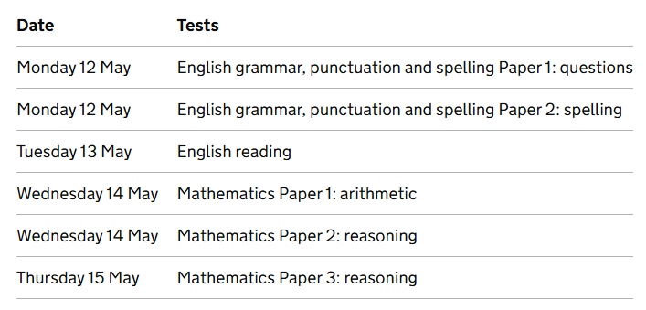
When are they taking place?

Slide 4
How do the tests take place?
The tests all take place in normal school time, under test conditions.
Pupils will not be allowed to talk to each other during the tests.
The completed papers are sent away to be marked externally.
Results are returned to school in July.
The tests vary in length but last no longer than 60 minutes:
- Reading: 60 minutes
- Grammar, Punctuation & Vocabulary: 45 minutes
- Spelling: 15 minutes
- Arithmetic: 30 minutes
- Mathematical Reasoning: 2 papers of 40 minutes each.
https://www.gov.uk/government/publications/key-stage-2-tests-2018-mathematics-test-materials
https://www.gov.uk/government/publications/key-stage-2-tests-2019-english-grammar-punctuation-and-spelling-test-materials
https://www.gov.uk/government/publications/key-stage-2-tests-2019-english-reading-test-materials

Slide 5
How are the tests graded?
The marked tests will provide the following information:
- A raw score (i.e. number of marks)
- A scaled score (see below)
- An indication of whether the national standard has been met.
In scaled scores, a score of 100 represents the national standard. The lowest is 80 and the highest is 120.
After each test is marked, it will be converted into a scaled score and that will show whether a pupil is working at the national standard, or above or below it.
A pupil will need to achieve a scaled score of 100 to show that they have met the national standard on the test.
There are not separate tests for higher attaining pupils, but they would expect a scaled score of 110+ which would indicate the pupil is working above the expected standard.
https://www.gov.uk/government/publications/2019-scaled-scores-at-key-stage-2

Slide 6
The Reading Test
The test assesses whether pupils’ comprehension of age appropriate texts meets the national standard. There will be numerous questions on inference, vocabulary and authorial choice.
Pupils will have 60 minutes to complete the test, including reading the texts and writing the answers.
The test will have three different texts to read, drawing on fiction, non-fiction or poetry.
Questions are focused around the following areas (called ‘content domains’):
- give/explain the meaning of words in context
- retrieve and record information/identify key details from fiction and non-fiction
- summarise main ideas from more than one paragraph
- make inferences from the text/explain and justify inferences with evidence from the text
- predict what might happen from details stated and implied
- identify/explain how information/narrative content is related and contributes to
meaning as a whole
- identify/explain how meaning is enhanced through choice of words and phrases
- make comparisons within the text

Slide 7
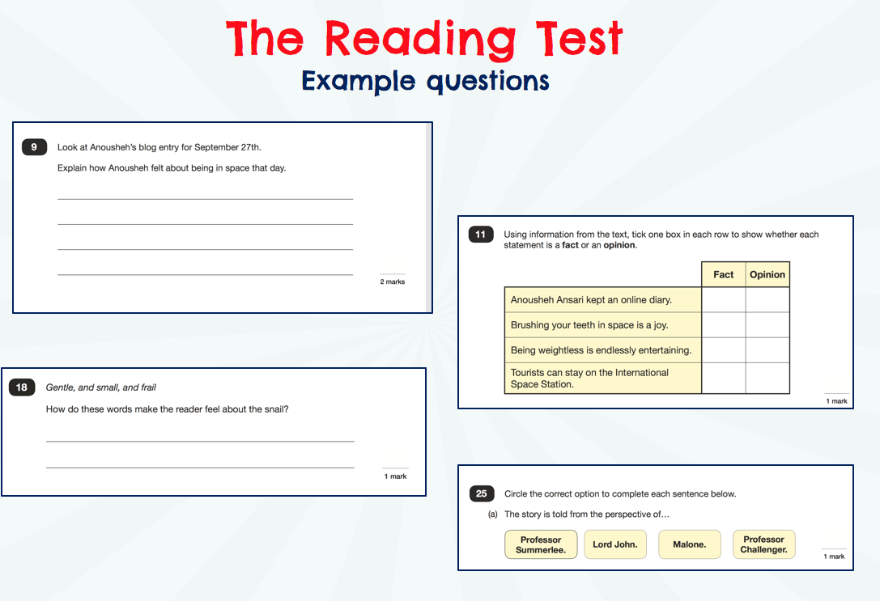
©Ks2history 2018

Slide 8
The GPS Tests
There are two tests: a short spelling test and a longer paper testing grammar, punctuation and vocabulary.
The spelling test lasts approximately 15 minutes and pupils will need to spell words in context by filling in the gaps in sentences.
The grammar, punctuation and vocabulary test lasts for 45 minutes.
Pupils need a good working knowledge of technical vocabulary used to describe grammatical terms and punctuation marks.
Questions in the grammar test are focused around the following areas (called ‘content domains’):
- Grammatical terms/word classes
- Functions of sentences
- Combining words, phrases and clauses
- Verb forms, tenses and consistency
- Punctuation
- Vocabulary
- Standard English and formality

Slide 9
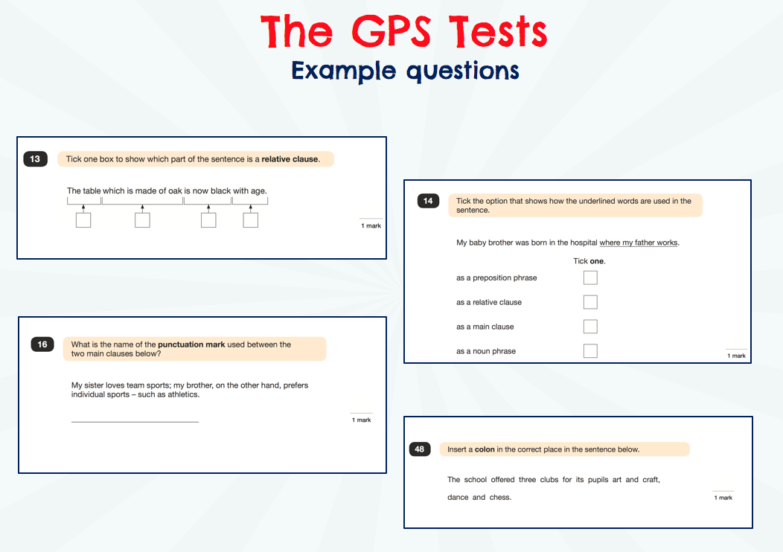
©Ks2history 2018

Slide 10
The Maths Tests
There are three tests: one arithmetic paper and two reasoning papers.
Paper 1 (arithmetic) lasts 30 minutes and assesses pupils’ confidence using methods of calculation as well as fractions, decimals and percentages. It covers curriculum content from all of KS2.
Papers 2 & 3 (reasoning) last 40 minutes each and focus on problem solving, fluency and applying mathematical reasoning.
Questions cover the following areas (called ‘content domains’):
- Number and place value
- Addition, subtraction, multiplication and division (calculations)
- Geometry – properties of shapes
- Geometry – position and direction
- Statistics
- Measurement
- Algebra
- Ratio and proportion
- Fractions, decimals and percentages.
Questions will increase in difficulty as the paper progresses

Slide 11
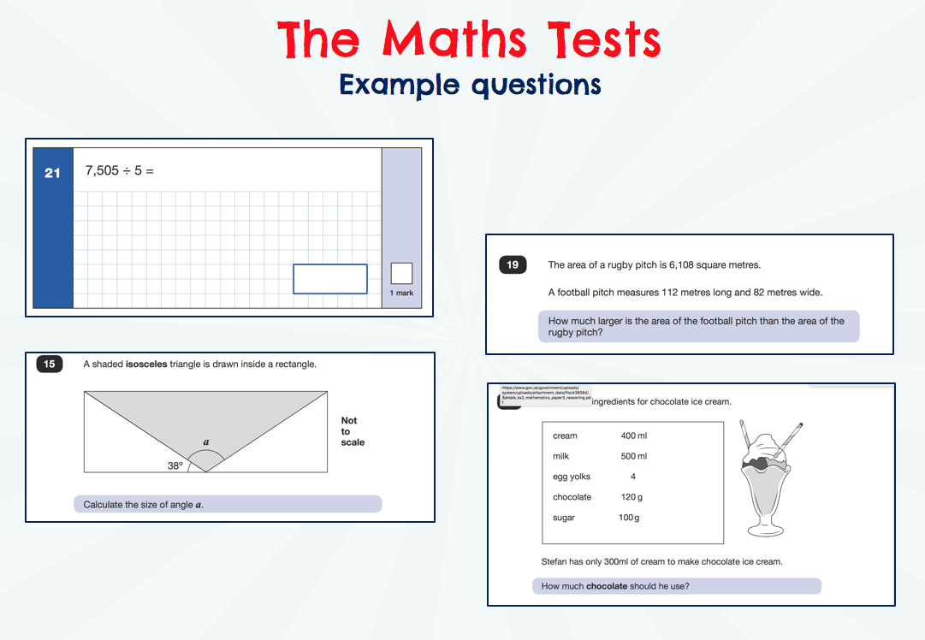
©Ks2history 2018

Slide 12
Other Assessments
There is no writing SATS test.
Writing assessments will be formed from judgements made by the teacher, looking at evidence from writing collected over the course of the year.
The teacher will moderate their assessments with other professionals to make sure there is a consistent standard across the country.
Final judgements will be reported to parents at the same time as the other assessment results.

Slide 13
How can I help my child?
Help children not to feel worried or pressured about SATS. All that is asked is that they try their best, but please reassure children that the SATS should not be causing anxiety. Do give lots of praise and encouragement!
Help children with organising their homework (including spellings and mental arithmetic) and support their reading for pleasure activities.
Help them to have early nights and a healthy diet.
Help your child to have the best possible attendance at school.
Please speak to a member of staff if you have questions or concerns.
If your child is ill during the testing period, please inform school ASAP.

Slide 14
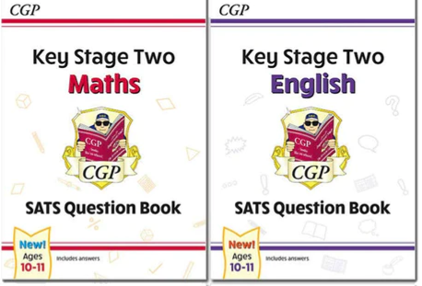
Revision and Support
Practise SATs Papers
CPG Books
TT Rockstars
Spelling Shed
Reading Regularly

Slide 15


Slide 16

©Ks2history 2018

